Slide 1
http://go.Illinois.edu/rna-seq

Slide 2
Introduction to Biocluster
David Slater
Associate Director of High Performance Computing
February 2022

Slide 3
Why am I here?
My Advisor told me to come!
I want to see where my tax dollars go.
How does Google and Amazon do it?
I need to analyze a thousand different samples
In 1 day
My laptop from Best Buy is too slow to analyze a human genome.

Slide 4
What is a Cluster?
Dictionary definition
A group or bunch of something
In computing
A group of loosely coupled computers that work closely together

Slide 5
Why use a Cluster?
To run many serial applications on similar hardware
Tu run a large, parallel application more quickly
To share processing resources across a group of people
To reduce the costs of running applications
To reliably run applications that have a long run time
To share computational data with others quickly
To reduce downtime due to hardware faults

Slide 6
Terminology
Head Node – The system that controls the cluster
Worker (Compute) Node – Systems that perform the computations in a cluster
Login Node – System that users log into to use a cluster
Storage Node – System that contains storage available for the cluster
Scheduler – Software that controls when jobs are run and the node they are run on

Slide 7
Terminology (cont)
Queue/Partition – A structure to which worker nodes and jobs are assigned
Serial – A job that runs within one node on one processor
Multithreaded – A job that with one node on more than one processor
Parallel – A job that can be run across several nodes
Shell – A program that users employ to type commands

Slide 8
Terminology (cont)
Script – A file that contains a series of commands that are executed
Job – A chunk of work that has been submitted to the cluster
Path – Where something is in the directory structure
I/O – General term for the transfer of data across a medium
Switch – A piece of equipment that connects computers together

Slide 9
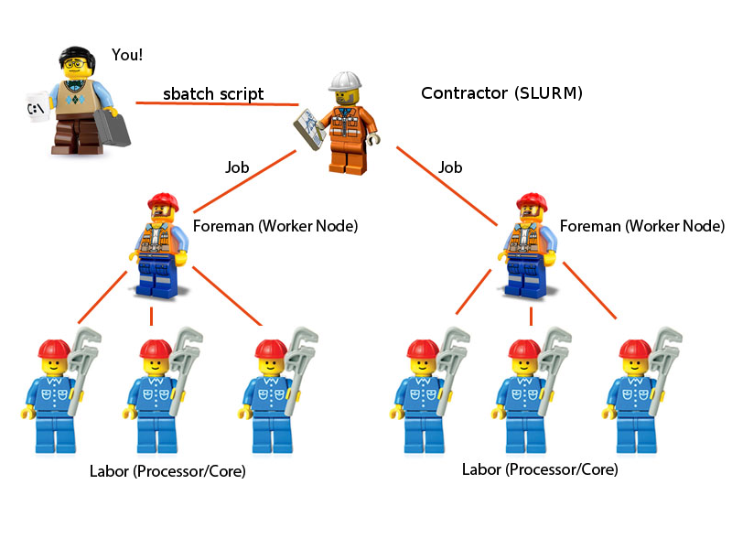
How Does a Cluster Work?

Slide 10
How does a Cluster Work? (cont)
Think of a cluster as a building contractor
The site manager (the job scheduler SLURM) determines what work need to be done and in what order. He works in an office (the head node)
The foremen (worker nodes) manage a team of workers (processors). The foremen manage the teams with differing specialties (queues/partitions)
When you want something done, you can drop off blueprints (a job script) with the site manager.
You can also say you want to talk to a worker directly, then the site manager will assign worker(s) from a foreman’s team.

Slide 11
History of HPC at the IGB
Hive (2006)
48 cores, 192GB of RAM
Classroom (2008)
192 cores, 384GB of RAM
EBI (2008)
200 cores, 400GB of RAM
Computation (2009)
80 cores, 240GB of RAM

Slide 12
History of HPC at the IGB (cont)
Biocluster (2011)
Initially composed of existing HPC resources
Default queue updated in 2013
Single copy GPFS system
10 GbE networking
Biocluster V2 (2018)
Initially composed of HPC resources from Biocluster
Double copy GPFS system
Normal and Low Memory queues updated 2019
40 GbE networking

Slide 13
Future of HPC at the IGB
Biocluster V3 (2022)
Summer/Fall 2022
Composed of existing resources
New GPU Node(s) with Geforce RTX 3080 GPUs
2 Petabytes Double Copy GPFS Filesystem (1PB usable space)
GPFS Snapshots enabled. Allows you to retrieve deleted data

Slide 14
What Partition do I use?
Normal (default)
Jobs that use more than 5GB of RAM
Large multhreaded jobs
Lowmem
Jobs that need less than 5GB of RAM
Jobs that need 12 cores or less
GPU
Jobs that need access to GPUs for acceleration

Slide 15
Other Biocluster Services
Normal (default) ($1.19/core/day)
Five 72 core nodes
1.2TB RAM
40GbE
Lowmem ($0.50/core/day)
Eight 12 core nodes
64GB RAM
10GbE
Storage ($8.75/TB/month)
Replicated data across 10 storage nodes
NOT BACKED UP

Slide 16
Other Biocluster Services
Biodatabase (free)
High performance MySQL server
Jupyter
Runs R and Python in a web browser
Singularity Containers
Loads Docker and Singularity containers
Mirrors (free)
Local datasets, let us know if you want to add one
Archive ($200/TB/10 yr)
Long term data storage for completed projects
Saves data to tape

Slide 17
Why so Many Fee Based Services?
Hive Cluster Experience
Important vs Unimportant
Further Evidence from Pittsburg Supercomputing Center (PSC)
Long queues
Overused resources
Storage Issues
WORSE Data
Large Datasets
Sustainability
Insures funding for new resources

Slide 18
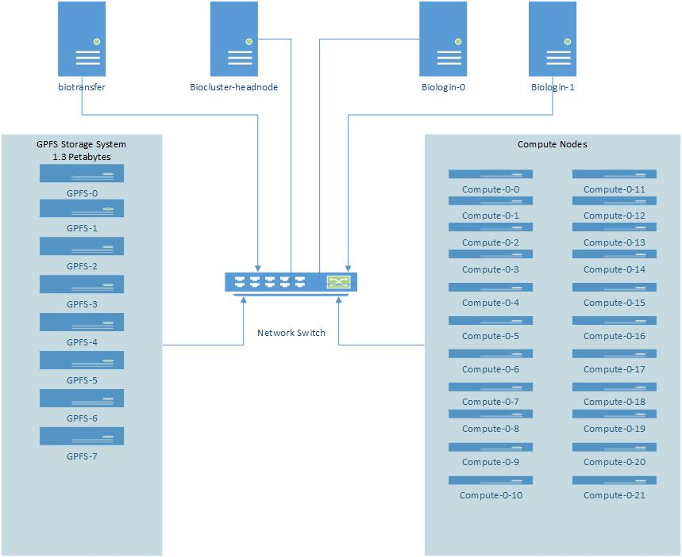
Biocluster Layout

Slide 19
Log into Biocluster
Open MobaXterm
Click on “Start Local Terminal”
Type “ssh username@biologin.igb.illinois.edu”
Enter your password
Answer “No” when asked to save your password
If successful, your prompt should look something like: [username@biologin ~]

Slide 20
Important Commands: squeue
Shows the status of jobs running in the queues
You can also show the status of just your jobs
CD is complete, R is running, PD is waiting to run

Slide 21
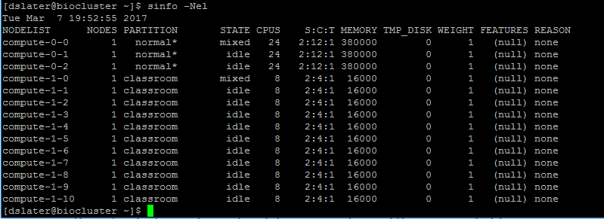
Important Commands: sinfo
Show the properties of queues and nodes

Slide 22
Important Commands: scontrol
Get more details about a job
[biocluster]$ scontrol show job 1148
UserId=dslater(683) GroupId=dslater(683)
Priority=4294901672 Nice=0 Account=(null) QOS=normal
JobState=RUNNING Reason=None Dependency=(null)
Requeue=1 Restarts=0 BatchFlag=0 Reboot=0 ExitCode=0:0
RunTime=00:25:35 TimeLimit=UNLIMITED TimeMin=N/A
SubmitTime=2017-03-07T19:33:20 EligibleTime=2017-03-07T19:33:20
StartTime=2017-03-07T19:33:20 EndTime=Unknown
PreemptTime=None SuspendTime=None SecsPreSuspend=0
Partition=normal AllocNode:Sid=biocluster:117639
ReqNodeList=(null) ExcNodeList=(null)
NodeList=compute-0-0
BatchHost=compute-0-0
NumNodes=1 NumCPUs=1 CPUs/Task=1 ReqB:S:C:T=0:0:*:*
TRES=cpu=1,mem=15800,node=1
Socks/Node=* NtasksPerN:B:S:C=0:0:*:* CoreSpec=*
MinCPUsNode=1 MinMemoryCPU=15800M MinTmpDiskNode=0
Features=(null) Gres=(null) Reservation=(null)
Shared=OK Contiguous=0 Licenses=(null) Network=(null)
Command=/bin/bash
WorkDir=/home/a-m/dslater
Power= SICP=0

Slide 23
Important Commands: module
Loads the necessary environment for a program
module avail
Shows all modules available, or all the software installed
module load
Load the environment for a program
module list
Shows modules loaded
module unload
Removes a loaded module
module purge
Removes all loaded modules

Slide 24
Pay attention to module messages
module load STAR/2.7.6a-IGB-gcc-8.2.0
module purge
module load picard/2.10.1-Java-1.8.0_152
module purge
module load CheckM/1.1.3-IGB-gcc-8.2.0-Python-3.7.2

Slide 25
Transferring Files
SFTP
Cyberduck (OSX, Windows) https://cyberduck.io
WinSCP (Windows) https://winscp.net/eng/index.php
FileZilla (OSX, Windows, Linux) https://filezilla-project.org
Globus Online
Transfers large files reliably and easily
Transfer between clusters around the world
Best way to get data from Biotech Center
http://help.igb.illinois.edu/Globus

Slide 26
Resources
Biocluster home page
http://biocluster.igb.illinois.edu
Biocluster accounting
http://biocluster.igb.illinois.edu/accounting/
SLURM script generator
http://www-app.igb.illinois.edu/tools/slurm/
SLURM tutorials
https://slurm.schedmd.com/tutorials.html
SLURM quick reference
https://slurm.schedmd.com/pdfs/summary.pdf

Slide 27
Enough Already, Lets use it
Detailed policies and directions
http://help.igb.illinois.edu/Biocluster
Do not install software yourself, email help@igb.illinois.edu
When we install software, then everyone can use it
Program running slow? E-mail us!
Don’t know what resources to use? E-mail us!
Any other questions? Email us!

Slide 28
Interactive Jobs
When you need to provide unpredictable input
[hpcinstru02@biologin-0 ~]$ hostname
biologin-0.igb.illinois.edu
[hpcinstru02@biologin-0 ~]$ srun -p classroom --pty bash
[hpcinstru02@compute-1-0 ~]$ hostname
compute-1-0
[hpcinstru02@compute-1-0 ~]$ exit
exit
[hpcinstru02@biologin-0 ~]$ hostname
biologin-0.igb.illinois.edu
[hpcinstru02@biocluster ~]$

Slide 29
Bash Scripts
Bash scripts are a series of commands that can be grouped together within files to accomplish a series of tasks.
This allows you to run one command instead of several successive commands.

Slide 30
Example Bash Script
Start an interactive job to the classroom queue
This program waits 15 seconds and then prints out “Hello World” in the terminal
Make this file, give it execute permissions, and run
#!/bin/bash
#This program sleeps for 15 seconds and prints
#"Hello World" to the command line
sleep 15
echo "Hello World"

Slide 31
FastQC
FastQC is a quality control application for high throughput sequence data
Checks the quality of their sequence data
Generates an HTML report
http://www.bioinformatics.babraham.ac.uk/projects/fastqc/

Slide 32
Prepare to Run Jobs
Copy example data to your home directory
$ mkdir unix_exercise_hpc
$ cd unix_exercise_hpc/
$ cp -r /home/classroom/hpcbio/unix_exercise_hpc/data/raw-seq .
$ cp -r /home/classroom/hpcbio/unix_exercise_hpc/data/raw-seq-ordered .
$ cp -r /home/classroom/hpcbio/unix_exercise_hpc/data/blast .
$ mkdir -p results/fastqc-rawseq
$ mkdir results/blast
$ mkdir results/fastqc-rawseq-ordered
$ mkdir results/fastqc-rawseq-unordered

Slide 33
Important Commands: sbatch
Submit a job to the cluster
-p partition you want to summit to
Default is “normal”
-N Number of nodes
Default is 1
-n Number of CPUs per node
Default is 1
Many more options
https://slurm.schedmd.com/sbatch

Slide 34
Create the FastQC Job Script
Use a text editor to create a file name samplefastqc.sh that contains what follows:
#!/bin/bash
#SBATCH -N 1
#SBATCH –n 1
#SBATCH -p classroom
#SBATCH --mail-user=EMAIL@ADDRESS
#SBATCH --mail-type=ALL
#SBATCH -D /home/a-m/USERNAME/unix_exercise_hpc
module load FastQC
echo “Start FastQC Job”
sleep 20
fastqc -o results/fastqc-rawseq raw-seq/yeast_1_50K.fastq
echo “Finish FastQC Job”

Slide 35
Run the FastQC Job Script
Submit the job
[hpcinstru02@biocluster unix_exercise]$ sbatch samplefastqc.sh
Submitted batch job 1163
Check the status of the job
[hpcinstru02@biocluster unix_exercise]$ squeue
JOBID PARTITION NAME USER ST TIME NODES NODELIST(REASON)
1164 classroom fastqc.s hpcinstr R 0:02 1 compute-1-0

Slide 36
Check Output File for Errors
[hpcinstru02@biocluster unix_exercise_hpc]$ cat slurm-1165.out
Started analysis of yeast_1_50K.fastq
Approx 5% complete for yeast_1_50K.fastq
Approx 10% complete for yeast_1_50K.fastq
Approx 15% complete for yeast_1_50K.fastq
Approx 20% complete for yeast_1_50K.fastq
Approx 25% complete for yeast_1_50K.fastq
Approx 30% complete for yeast_1_50K.fastq
Approx 35% complete for yeast_1_50K.fastq
Approx 40% complete for yeast_1_50K.fastq
Approx 45% complete for yeast_1_50K.fastq
Approx 50% complete for yeast_1_50K.fastq
Approx 55% complete for yeast_1_50K.fastq
Approx 60% complete for yeast_1_50K.fastq
Approx 65% complete for yeast_1_50K.fastq
Approx 70% complete for yeast_1_50K.fastq
Approx 75% complete for yeast_1_50K.fastq
Approx 80% complete for yeast_1_50K.fastq
Approx 85% complete for yeast_1_50K.fastq
Approx 90% complete for yeast_1_50K.fastq
Approx 95% complete for yeast_1_50K.fastq
Approx 100% complete for yeast_1_50K.fastq
Analysis complete for yeast_1_50K.fastq

Slide 37
Important Things to Note
Job length
If over 24 hours, can this be split up, can threads be increased?
Many small files
To be avoided!
Group into larger files
Data
Save money by removing temp files
Archive data as soon as reasonable
Let us know if you are adding several TB of data
Use /scratch whenever possible for temporary files

Slide 38
Important Things to Note
Make sure you are not on the login node when you launch an application
You can check the system you are on by typing “hostname”
Make sure you reserve as many processors as you need
A mismatch here can increase your runtime or costs
Make sure you reserve as much RAM as needed
Overestimating increases cost, underestimating crashes
Know which resources work the best
Sometimes using a gpu or lowmem system is better

Slide 39
Data
Group Folder
Created by CNRG for you in /home/labs or /home/groups
Need a CFOP to charge
Sharing data with another user
Send files with /home/a-m/dropboxes/USERNAME
Or /home/n-z/dropboxes/USERNAME
Receive files at /home/a-m/USERNAME/dropbox
Or /home/n-z/USERNAME/dropbox
No HIPAA Data is allowed on the biocluster

Slide 40
SLURM Environment Variables
$SLURM_JOB_ID – The job number
Assigned automatically by SLURM
$SLURM_JOB_NAME – The name of the job
Similar to the script name
Or you can specify one with -J
$SLURM_NTASKS – Number of reserved Processors
Assigned automatically by SLURM
Value is the multiple of the -n and -N values

Slide 41
Multi-Processor Jobs
The program must support it!
Our default nodes have 72 cores. Most programs loose efficiency after 8 or 16 processors.
Money adds up if not properly submitted
Try “program –help” or “man program”
Use $SLURM_NTASKS

Slide 42
Create the BLAST Job Script
Use SLURM Script Generator
https://www-app.igb.illinois.edu/tools/slurm/

Slide 43
Create the BLAST Job Script
Save as blast.sh
#!/bin/bash
#SBATCH -N 1
#SBATCH –n 4
#SBATCH -p classroom
#SBATCH --mail-user=EMAIL@ADDRESS
#SBATCH --mail-type=ALL
#SBATCH -D /home/a-m/USERNAME/unix_exercise_hpc
module load BLAST+/2.7.1-IGB-gcc-4.9.4
module load ncbi-blastdb/20201212
echo “Start BLAST Job”
blastp -db swissprot \
-query blast/query.txt \
-out results/blast/results.txt \
-num_threads $SLURM_NTASKS
echo “Finish BLAST Job”

Slide 44
Run the BLAST Job Script
Submit the job
[hpcinstru02@biocluster unix_exercise_hpc]$ sbatch blast.sh
Submitted batch job 1163
Check the status of the job
[hpcinstru02@biocluster unix_exercise_hpc]$ squeue
JOBID PARTITION NAME USER ST TIME NODES NODELIST(REASON)
1164 classroom blast.s hpcinstr R 0:02 1 compute-1-0

Slide 45
Check BLAST Job Stats
sacct can get stats for a job after its completed
https://slurm.schedmd.com/sacct.html
sacct -j 6694365 –format=JobID,State,Elapsed,NCPUS,MaxRSS
seff can get stats for a job after its completed
seff 6694365

Slide 46
GPU Jobs – Example
Use gpu partition
Reserve gpus with --gres parameter
Maximum of 4 GPUs
#!/bin/bash #SBATCH -N 1 #SBATCH –n 1 #SBATCH -p gpu
#SBATCH --gres=gpu:1 #SBATCH –mail-user=dslater@illinois.edu #SBATCH --mail-type=ALL #SBATCH -D /home/a-m/dslater
module load Tensorflow-GPU/2.3.1-IGB-gcc-8.2.0-Python-3.7.2

Slide 47
Job Arrays
A way to run the same commands on many (hundreds, thousands) of datasets/samples.
A variable called $SLURM_ARRAY_TASK_ID is used to determine the element of the array being run.
#SBATCH --array=1-1000
$SLURM_ARRAY_TASK_ID becomes 1 in first job, 2 in second job, etc…

Slide 48
Bash Variables
cd raw-seq
i=1
ls -l yeast_${i}_50K.fastq
i=2
ls -l yeast_${i}_50K.fastq

Slide 49
Without Job Arrays – Numbered Files
#!/bin/bash #SBATCH -N 1 #SBATCH –n 1 #SBATCH -p classroom #SBATCH --mail-user=EMAIL@ADDRESS #SBATCH --mail-type=ALL #SBATCH -D /home/a-m/USERNAME/unix_exercise_hpc
module load FastQC/0.11.8-Java-1.8.0_152 echo "Starting FastQC job“
fastqc -o results/fastqc-rawseq-ordered raw-seq-ordered/yeast_1_50K.fastq
fastqc -o results/fastqc-rawseq-ordered raw-seq-ordered/yeast_2_50K.fastq
fastqc -o results/fastqc-rawseq-ordered raw-seq-ordered/yeast_3_50K.fastq
fastqc -o results/fastqc-rawseq-ordered raw-seq-ordered/yeast_4_50K.fastq
fastqc -o results/fastqc-rawseq-ordered raw-seq-ordered/yeast_5_50K.fastq
fastqc -o results/fastqc-rawseq-ordered raw-seq-ordered/yeast_6_50K.fastq
echo "Finish FastQC job"

Slide 50
Job Arrays – Numbered Files
Here is an example SLURM script for a job array. Save as numbered_job_array.sh
#!/bin/bash #SBATCH -N 1 #SBATCH –n 1 #SBATCH -p classroom #SBATCH --mail-user=EMAIL@ADDRESS #SBATCH --mail-type=ALL #SBATCH --array=1-6 #SBATCH -D /home/a-m/USERNAME/unix_exercise_hpc
module load FastQC/0.11.8-Java-1.8.0_152 echo "Starting FastQC job“
sleep 20
fastqc -o results/fastqc-rawseq-ordered \
raw-seq-ordered/yeast_${SLURM_ARRAY_TASK_ID}_50K.fastq
echo "Finish FastQC job"

Slide 51
View Job Array
#squeue -u USERNAME
[hpcinstru02@biocluster unix_exercise_hpc]$ squeue -u hpcinstru02
JOBID PARTITION NAME USER ST TIME NODES NODELIST(REASON)
1152 classroom bash hpcinstr R 2:17:32 1 compute-1-0
1153 classroom bash hpcinstr R 2:17:12 1 compute-1-0
1207_1 classroom numbered hpcinstr R 0:02 1 compute-1-0
1207_2 classroom numbered hpcinstr R 0:02 1 compute-1-0
1207_3 classroom numbered hpcinstr R 0:02 1 compute-1-0
1207_4 classroom numbered hpcinstr R 0:02 1 compute-1-0
1207_5 classroom numbered hpcinstr R 0:02 1 compute-1-0
1207_6 classroom numbered hpcinstr R 0:02 1 compute-1-1

Slide 52
Job Arrays – Unnumbered Files
Start by creating a list of all of the unnumbered filenames
$ ls raw-seq/ > unnumbered_filenames.txt

Slide 53
Job Arrays – Unnumbered Files (cont)
Here is an example slurm array script for fastqc jobs that have unnumbered filenames.
#!/bin/bash #SBATCH -N 1 #SBATCH –n 1 #SBATCH -p classroom #SBATCH --mail-user=EMAIL@ADDRESS #SBATCH --mail-type=ALL #SBATCH --array=1-6 #SBATCH -D /home/a-m/USERNAME/unix_exercise_hpc
module load FastQC/0.11.8-Java-1.8.0_152
echo "Starting FastQC job“
sleep 20
line=$(sed -n -e "$SLURM_ARRAY_TASK_ID p" unnumbered_filenames.txt)
fastqc -o results/fastqc-rawseq-unordered raw-seq/${line}
echo "Finish FastQC job"

Slide 54
Job Dependencies
Instructions on how jobs relate to other jobs
Useful for if you want to run a series of jobs that depend on the output from other jobs
Examples:
-d depend=afterok:jobid Starts after jobid has finished without errors.
-d depend=afterok:jobid,before:jobid2 Starts after jobid is finished, but not until jobid2 has started.
-d depend:afterok:jobid -d depend:afterok:jobid2 Starts after both jobid and jobid2 have finished.
-d depend=afterokarray:jobid Starts after the job array jobid has finished without errors.

Slide 55
Job Dependencies
Why would you do this:
Mostly for job pipelines, a series of programs that depend on each other’s output that are all submitted at once.
Example:
Step 1:
[biocluster]$ sbatch preprocessing-step.sh Submitted batch job 18866
Step 2:
[biocluster]$ sbatch -d after:18866 job-array-step.sh Submitted batch job 18870
Step 3:
[biocluster]$ sbatch –d afterok:18870 postprocessing-step.sh Submitted batch job 18867

Slide 56
What is Wrong
#!/bin/bash
# ----------------SLURM Parameters----------------
#SBATCH -p normal
#SBATCH -n 1
#SBATCH --mem=15g
#SBATCH -N 1
#SBATCH –D /home/a-m/dslater
# ----------------Load Modules--------------------
# ----------------Commands------------------------
python /home/a-m/dslater/example_script.py

Slide 57
What is Wrong
The module is not loaded
#!/bin/bash
# ----------------SLURM Parameters----------------
#SBATCH -p normal
#SBATCH -n 1
#SBATCH --mem=15g
#SBATCH -N 1
#SBATCH –D /home/a-m/dslater
# ----------------Load Modules--------------------
module load Python/2.7.13-IGB-gcc-4.9.4
# ----------------Commands------------------------
python /home/a-m/dslater/example_script.py

Slide 58
What is Wrong II
#!/bin/bash
# ----------------SLURM Parameters----------------
#SBATCH -p normal
#SBATCH -n 24
#SBATCH --mem=10g
#SBATCH -N 1
# ----------------Load Modules--------------------
module load BLAST+/2.6.0-IGB-gcc-4.9.4
# ----------------Commands------------------------
blastn -query fasta.file -db database_name -outfmt 6 \
-num_alignments 1 -num_descriptions 1 -out output_file

Slide 59
What is Wrong II
Number of processors and no working directory
#!/bin/bash
# ----------------SLURM Parameters----------------
#SBATCH -p normal
#SBATCH -n 24
#SBATCH --mem=10g
#SBATCH -N 1
#SBATCH –D /home/a-m/dslater
# ----------------Load Modules--------------------
module load BLAST+/2.6.0-IGB-gcc-4.9.4
# ----------------Commands------------------------
blastn -query fasta.file -db database_name -outfmt 6 num_alignments 1 \ -num_descriptions 1 -out output_file -num_threads 24

Slide 60
What is Wrong II
Better to use $SLURM_NTASKS
#!/bin/bash
# ----------------SLURM Parameters----------------
#SBATCH -p normal
#SBATCH -n 24
#SBATCH --mem=10g
#SBATCH -N 1
#SBATCH –D /home/a-m/dslater
# ----------------Load Modules--------------------
module load BLAST+/2.6.0-IGB-gcc-4.9.4
# ----------------Commands------------------------
blastn -query fasta.file -db database_name -outfmt 6 num_alignments 1 \ -num_descriptions 1 -out output_file -num_threads $SLURM_NTASKS

Slide 61
What is Wrong III
#!/bin/bash
# ----------------SLURM Parameters----------------
#SBATCH -p lowmem
#SBATCH -n 1
#SBATCH --mem=100g
#SBATCH -N 1
#SBATCH -D /home/a-m/dslater
# ----------------Load Modules--------------------
module load R/3.3.3-IGB-gcc-4.9.4
# ----------------Commands------------------------
Rscript /home/a-m/dslater/R_example.R

Slide 62
What is Wrong III
Wrong partition/mem requirements too high
#!/bin/bash
# ----------------SLURM Parameters----------------
#SBATCH -p normal
#SBATCH -n 1
#SBATCH --mem=100g
#SBATCH -N 1
#SBATCH -D /home/a-m/dslater
# ----------------Load Modules--------------------
module load R/3.3.3-IGB-gcc-4.9.4
# ----------------Commands------------------------
Rscript /home/a-m/dslater/R_example.R

Slide 63
What is Wrong IV
#!/bin/bash
# ----------------SLURM Parameters----------------
#SBATCH -p gpu
#SBATCH -n 1
#SBATCH --mem=100g
#SBATCH -N 1
#SBATCH -D /home/a-m/dslater
# ----------------Load Modules--------------------
module load Tensorflow-GPU/2.3.1-IGB-gcc-8.2.0-Python-3.7.2
# ----------------Commands------------------------
python /home/a-m/dslater/tensor_models.py

Slide 64
What is Wrong IV
Wrong partition or gpu resources not specified
#!/bin/bash
# -------------SLURM Parameters----------------
#SBATCH -p gpu
#SBATCH --gres=gpu:1
#SBATCH -n 1
#SBATCH --mem=100g
#SBATCH -N 1
#SBATCH -D /home/a-m/dslater
# ----------------Load Modules--------------------
module load Tensorflow-GPU/2.3.1-IGB-gcc-8.2.0-Python-3.7.2
# ----------------Commands------------------------
#Running python here
python /home/a-m/dslater/tensor_models.py

Slide 65
What is Wrong V
# ----------------SLURM Parameters----------------
#SBATCH --partition normal
#SBATCH --ntasks 1
#SBATCH --mem=15g
#SBATCH --nodes 1
#SBATCH --chdir /home/a-m/dslater
# ----------------Load Modules--------------------
module load SAMtools/1.11-IGB-gcc-8.2.0
# ----------------Commands------------------------
samtools stats /home/a-m/dslater/example.bam

Slide 66
What is Wrong V
No bash shebang line, #!/bin/bash
Can use long names for SBATCH parameters
#!/bin/bash
# ----------------SLURM Parameters----------------
#SBATCH --partition normal
#SBATCH --ntasks 1
#SBATCH --mem=15g
#SBATCH --nodes 1
#SBATCH --chdir /home/a-m/dslater
# ----------------Load Modules--------------------
module load SAMtools/1.11-IGB-gcc-8.2.0
# ----------------Commands------------------------
samtools stats /home/a-m/dslater/example.bam

Slide 67
Thanks
HPCBio
Jessica Holmes
Jenny Drnevich
Lindsay Clark
CNRG
Daniel Davidson

